Slide 1
Inner metro
Inner south
Grounds for VCAT application:
Eastern
Initial rejection
Failure to decide
Contest conditions
Objector
Unknown
Northern
Southern
 2007 to 2017 VCAT rate
Western
Percentage
Notes:
Source: PPARS cleaned by grattan
Single and multi-dwellings. Excludes open applications and applications that were not necessary.
Total VCAT rate is for all finished applications from 2007. VCAT reasons are for VCAT cases from 2015 only.

Slide 2
Inner metro
Inner south
Grounds for VCAT application:
Eastern
Initial rejection
Failure to decide
Contest conditions
Objector
Unknown
Northern
Southern
Western
Percentage
Notes:
Source: PPARS cleaned by grattan
Single and multi-dwellings. Excludes open applications and applications that were not necessary.
Total VCAT rate is for all finished applications from 2007. VCAT reasons are for VCAT cases from 2015 only.

Slide 3
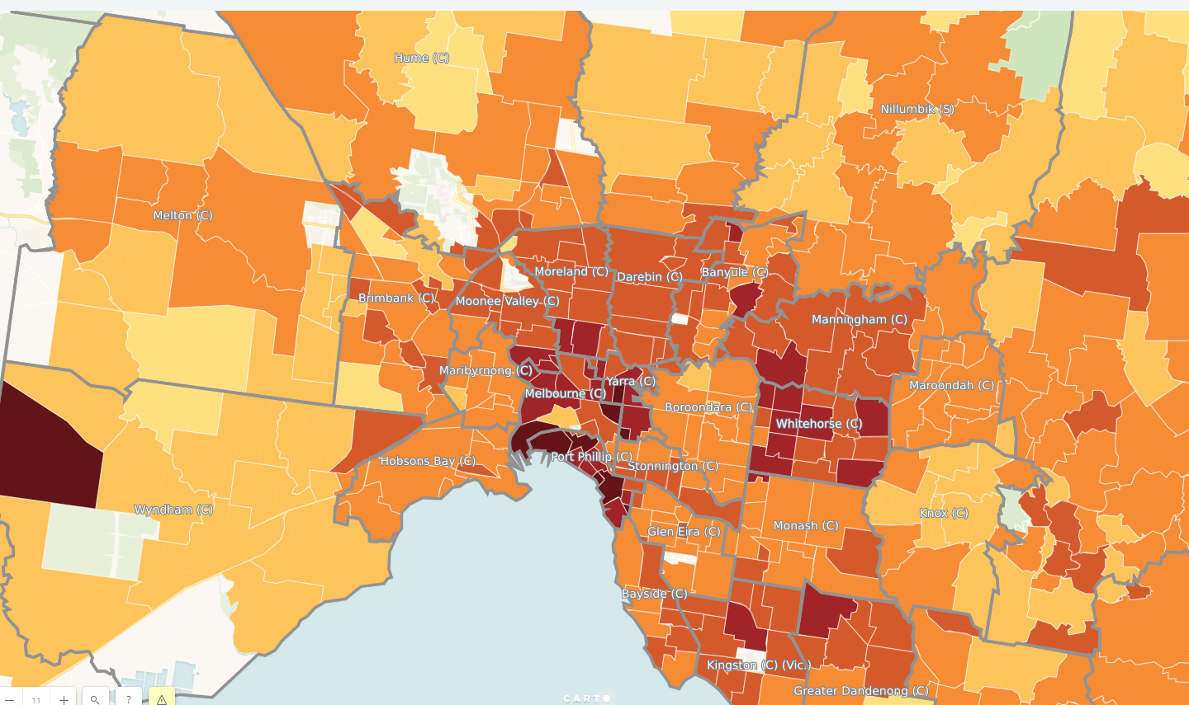
>250 days
200-250 days
150-200 days
100-150 days
50-100 days
< 50 days

